Slide 1
Data Communications sea-shore

Slide 2
Agenda
Data communication set-up
V-SAT alternatives
Challenges experienced
Investigations
Way forward
Discussions

Slide 3
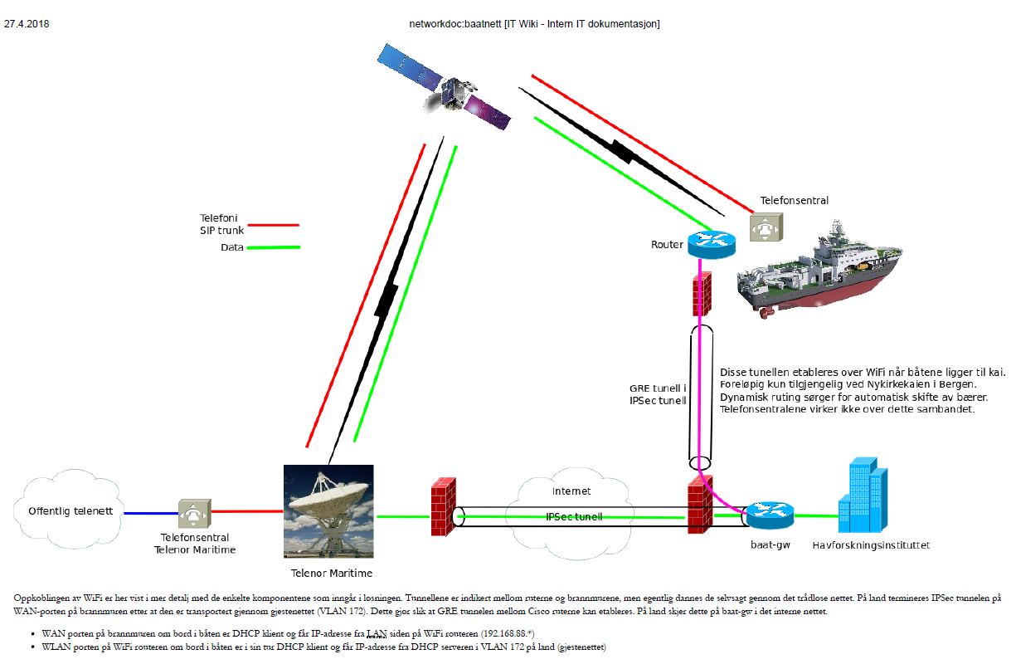

Slide 4
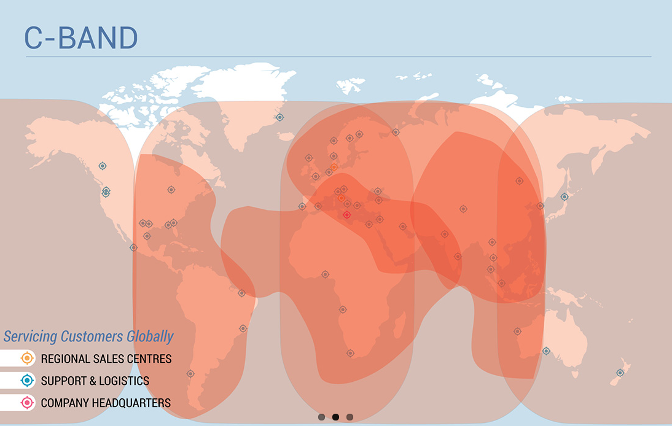
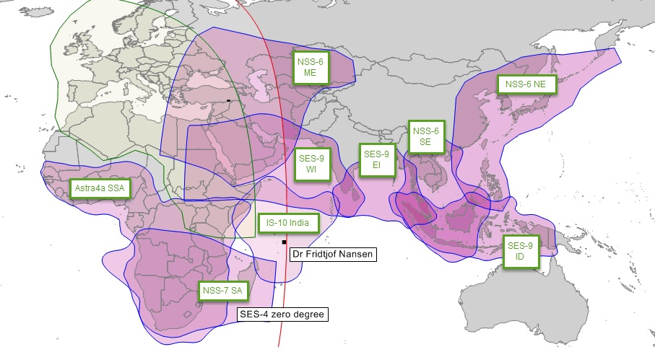
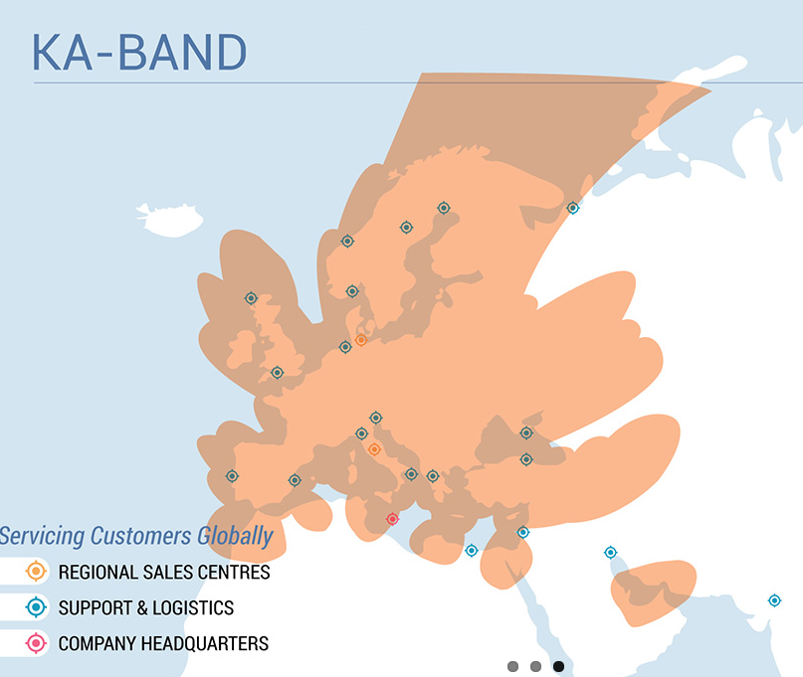
Ku-Band

Slide 5
Ku band coverage

Slide 6
Challenges operating DFN from West Africa, via East Africa to Tailand
Lost connection early starting up the east coast of Africa
Had to change satelite and our satcom provider had not prepared the router onboard correct for using another company satelite
Lost connection when crossing the Indian Ocean.
Area with no Ku band coverage
Generate back-log on e-mail system and Maintenance system.
Need better planning and close follow up on satcom provider. Every sat change need to be pre programmed on equipement onboard.
Evaluate acceptance to be without satcom for some days/weeks or install e.g. C-band antenna.

Slide 7
Overload on data traffic ?
On DFN we have Ku-band with 512kb/s as standard, but have had 1024kb/s for some months.
Bad access to internet for everyone onboard.
Restrictions on e-mail size. Only small attachments
Difficult to use web based administrative tools like purchasing.
Very high data traffic even when we disconnect many computers onboard.

Slide 8
Overload on data traffic ?
On KH we had C-band with 4mb/s when operating in the Antarctic this winter.
No challenges experienced. E-mail work ok.
Internet access for everybody onboard was ok. (many nice pictures on Facebook)
High cost
We changes to Ku band and 1024kb/s when the vessel is back in the North Sea.

Slide 9
DFN - The data traffic is on top most of the day

Slide 10
Increasing bandwith to 3mb/s gives longer periodes were the traffic is not on top.

Slide 11
Increasing bandwith to 3mb/s gives longer periodes were the traffic is not on top.

Slide 12
DFN back within sat range. Blocking of some web. access turned off at 12.00.
Struggle to take down e-mails and replicate TM maintenance system. When blocking of web. pages was removed, the use peaked.

Slide 13
Is there a minimum bandwith to operate computers onboard ?
To us it looks like there is a change in computer functions and general communication when we increased to 3mb/s on DFN and operated with 4mb/s on KH.
With DFN we have only two weeks experience, so more time is needed to conclude.

Slide 14
Discussions:
Any experience with «minimum required bandwidth» to operate computer systems onboard including communication with shore ?
Any experience with restriction on access to internet onboard ?
By procedures
By physical blocking of access
Any experience with split of net onboard. E.g. one net for vessel administration and one for scientific use ?

